Slide 1
Robotic Aesthetics
A twitter robot by Charles MacKay
@robotaesthetic1

Slide 2
Outline
Abstract
Flow chart
Web Crawler
Markov
Tweet
Demo
Libs used

Slide 3
Abstract
This creative robot will generate a new exercise of the day “EotD” every 24 hours. It works by scraping bodybuilding.com for every exercise available. It downloads all of the exercise descriptions as text, grouping them by muscle, title, and step number. A Markov chain is built and new text can be generated. The exercise description is overlaid over an image in order to bypass the 140 character limit, and also to look much cooler. The status is tweeted, using the twitter API, and is repeated every 24 hours.

Slide 4
Flow chart
Get Data
Web crawler gathers data from body building website
Markov chain built
Build strings
Train the Markov chain using the scraped data
Build image
Tweet!
Do some fancy string manipulation
Do some fancy image processing

Slide 5
Web crawler
The web crawler is needed in order to provide input text for the Markov chain.
I crawled the index of all exercises, and navigated to each page, and downloaded the exercise description by looking div class “guideContent” and downloading each of the <li> tag as the steps 1,2,3,4.
I then created data structures based off of each muscle group and categorized all of the workouts
I saved each step as $musclename$stepno.txt
I separately saved the workout names as a separate file in order to generate new exercise names

Slide 6
Sample size
Total of 659KB of text was parsed corresponding to the exercises on the right
learning: 57 exercises for Biceps
learning: 142 exercises for Shoulders
learning: 28 exercises for Calves
learning: 9 exercises for Neck
learning: 47 exercises for Lats
learning: 79 exercises for Triceps
learning: 91 exercises for Hamstrings
learning: 13 exercises for Adductors
learning: 210 exercises for Quadriceps
learning: 108 exercises for Chest
learning: 45 exercises for Middle Back
learning: 12 exercises for Abductors
learning: 30 exercises for Lower Back
learning: 26 exercises for Glutes
learning: 28 exercises for Forearms
learning: 16 exercises for Traps

Slide 7
Markov - markovify
My project uses markovify, “a simple, extensible Markov chain generator”.
It is the primary source of text generation to create new exercises.
The Markov chain works by undergoing transitions from one state to another on a state space, with the probability distribution of the next state depending only on the current state and not on the sequence of events that preceded it. [Wikipedia]
By analyzing the word frequency of the text, we can build a Markov model by with the weights to the next state being the probability that a certain word succeeds the current state’s word

Slide 8
Creating a status
After the Markov chain architecture is built, an exercise description is created as follows:
Pick a randomly selected muscle group from the list of available muscles
build 4 Markov chains by using $chosen_muscle1,2,3,4 .txt as inputs
Randomly generate a new exercise name by putting a mix of titles together
Have the Markov models generate a short sentence for each step
Using the Pillow python module, take a background image, and place the exercise description text over the image, and save the image.

Slide 9
Tweeting a status
Using the twitter module for python, Tweepy, we are easily able to tweet a status.
After configuring the twitter developer settings, we can access our API keys
Using a simple function update_with_media, we are able to tweet our picture along with the exercise name.
Repeat every 24 hours or however often you want.

Slide 10
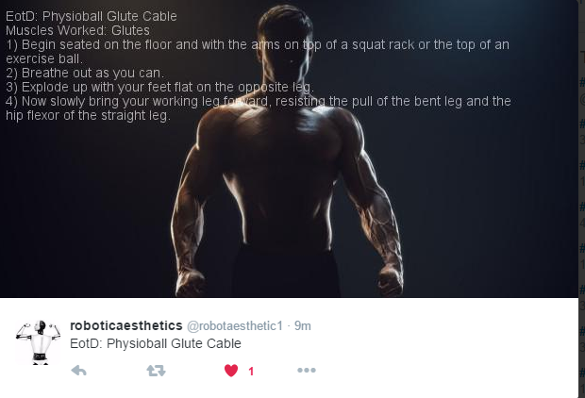
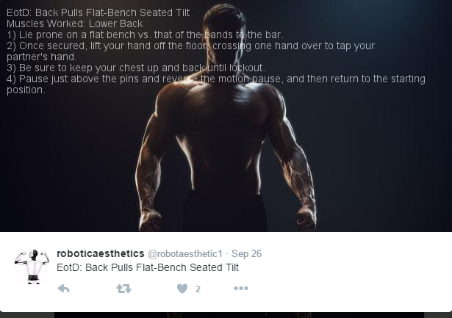
Favorite examples

Slide 11
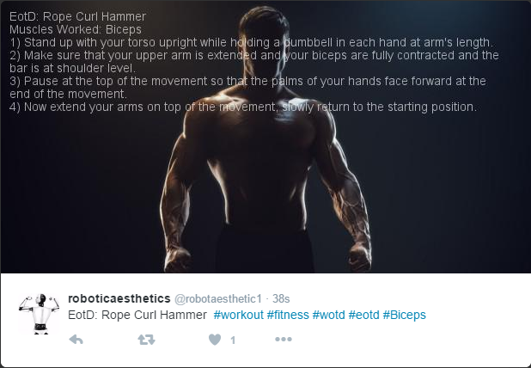
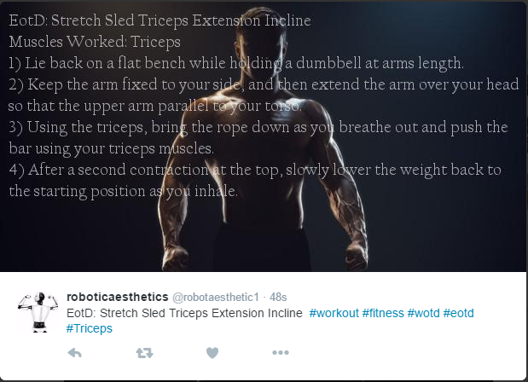
using a larger markov state size

Slide 12
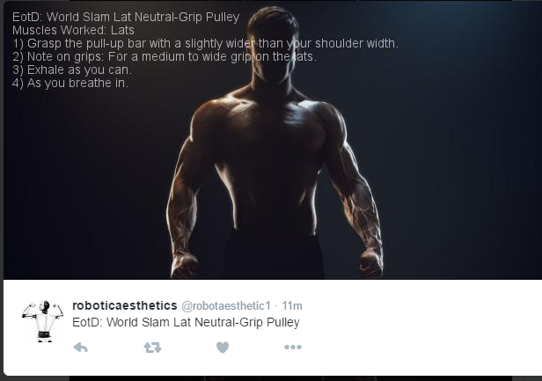
Funny one

Slide 13
improvements
The title generation (name of the exercise) is simply a random number passed into an index of titles. This results in some amusing names, but nonetheless it would be better of the title was sorted by adjective, noun, verb
I attempted to use the NLTK (natural language toolkit) module, but I could not get it to do simple identification of words.
I downloaded the Stanford NLE tagging module, but ran into java errors.
I plan on figuring out these bugs, and improving the title generation when I have more time.
I also would like to see if I could improve the Markov chain model, and setup more rules on how sentences are formed to avoid any redundancies or non-sense.
I also would want to make the text overlay look a bit cleaner, and more eye catching

Slide 14
Conclusion
I am happy with the results. The output text seems very close to an actual workout, and might actually be a healthy exercise
I have improved the text overlay, and am pleased with the new font
Once I get my linux system up, I might get this running on a chron job so it will tweet every 24 hours.

Slide 15
Libs used
Status generation
Markovify
Pillow
Tweepy
NTLK, Stanford NLE
Web Crawler
Urllib2
BeautifulSoup 4
Re (regex)
Standard python libs
Time, textwrap, sys, random, math

